Slide 1
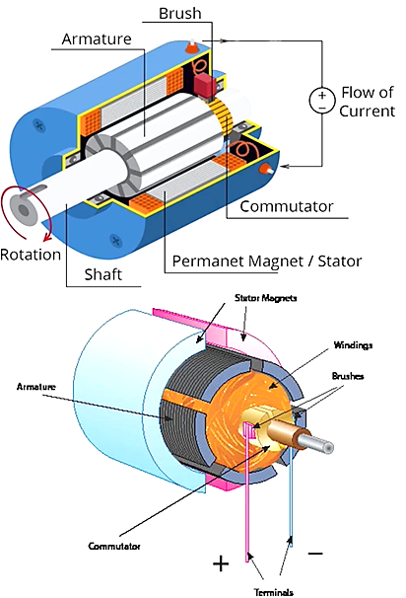
TYPES DC Motor
High starting torque
Widely used motor for traction application in the early1900s
Easy speed control
Withstand a sudden increase in load
High maintenance
Used in Indian railways

Slide 2

DC Motors

Slide 3
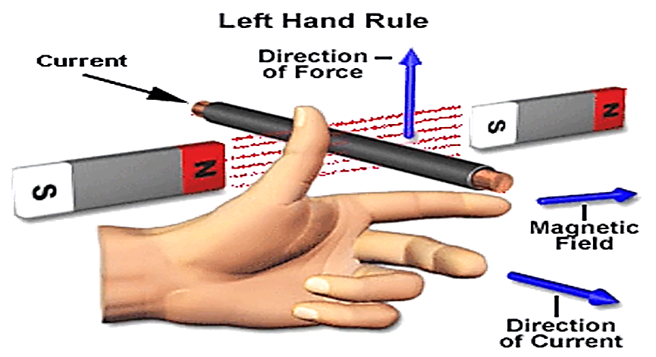
DC Motors

Slide 4
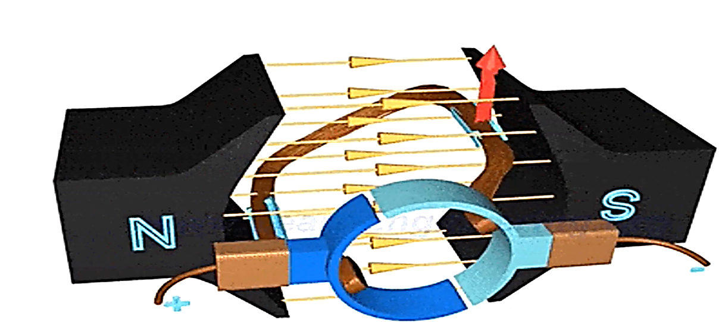

Slide 5
